Slide 1
Chapter 2 – Software Processes
Lecture 3 (Part 1)

Slide 2
Topics covered
Software process models
Process activities
Coping with change
The Rational Unified Process
  An example of a modern software process.

Slide 3
The software process
A structured set of activities required to develop a
software system.
Many different software processes but all involve:
  Specification – defining what the system should do;
  Design and implementation – defining the organization of the system and implementing the system;
  Validation – checking that it does what the customer wants;
  Evolution – changing the system in response to changing customer needs.
A software process model is an abstract representation of a process. It presents a description of a process from some particular perspective.

Slide 4
Software process descriptions
When we describe and discuss processes, we usually talk about the activities in these processes such as specifying a data model, designing a user interface, etc. and the ordering of these activities.
Process descriptions may also include:
  Products, which are the outcomes of a process activity;
  Roles, which reflect the responsibilities of the people involved in the process;
  Pre- and post-conditions, which are statements that are true before and after a process activity has been enacted or a product produced.

Slide 5
Plan-driven and agile processes
Plan-driven processes are processes where all of the process activities are planned in advance and progress is measured against this plan.
In agile processes, planning is incremental and it is easier to change the process to reflect changing customer requirements.
In practice, most practical processes include elements of both plan-driven and agile approaches.
There are no right or wrong software processes.

Slide 6
Software process models
The waterfall model
  Plan-driven model. Separate and distinct phases of specification and development.
Incremental development
  Specification, development and validation are interleaved. May be plan-driven or agile.
Reuse-oriented software engineering
  The system is assembled from existing components. May be plan-driven or agile.
In practice, most large systems are developed using a process that incorporates elements from all of these models.

Slide 7
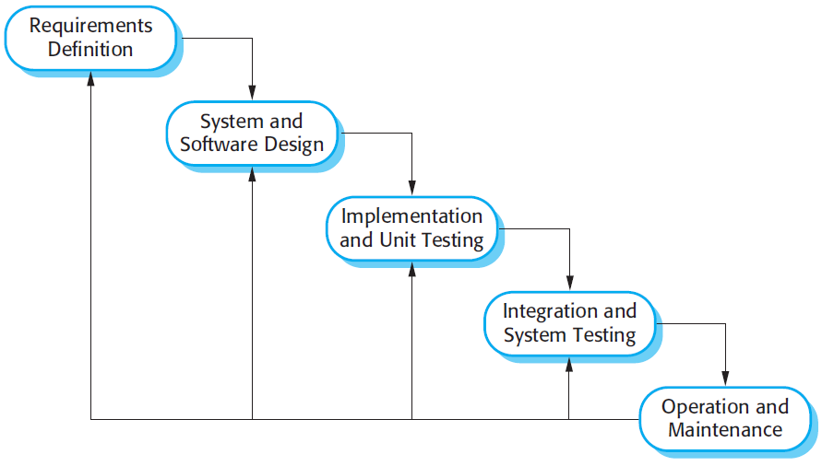
The waterfall model

Slide 8
Waterfall model phases
There are separate identified phases in the waterfall model:
  Requirements analysis and definition
  System and software design
  Implementation and unit testing
  Integration and system testing
  Operation and maintenance
The main drawback of the waterfall model is the difficulty of accommodating change after the process is underway. In principle, a phase has to be complete before moving onto the next phase.

Slide 9
Waterfall model problems
Inflexible partitioning of the project into distinct stages makes it difficult to respond to changing customer requirements.
  Therefore, this model is only appropriate when the requirements are well-understood and changes will be fairly limited during the design process.
  Few business systems have stable requirements.
The waterfall model is mostly used for large systems engineering projects where a system is developed at several sites.
  In those circumstances, the plan-driven nature of the waterfall model helps coordinate the work.

Slide 10
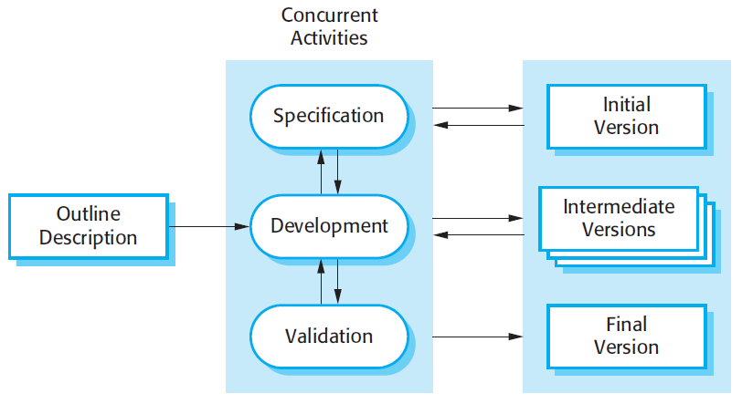
Incremental development

Slide 11
Incremental development benefits
The cost of accommodating changing customer requirements is reduced.
  The amount of analysis and documentation that has to be redone is much less than is required with the waterfall model.
It is easier to get customer feedback on the development work that has been done.
  Customers can comment on demonstrations of the software and see how much has been implemented.
More rapid delivery and deployment of useful software to the customer is possible.
  Customers are able to use and gain value from the software earlier than is possible with a waterfall process.

Slide 12
Incremental development problems
The process is not visible.
  Managers need regular deliverables to measure progress. If systems are developed quickly, it is not cost-effective to produce documents that reflect every version of the system.
System structure tends to degrade as new increments are added.
  Unless time and money is spent on refactoring to improve the software, regular change tends to corrupt its structure. Incorporating further software changes becomes increasingly difficult and costly.

Slide 13
Reuse-oriented software engineering
Based on systematic reuse where systems are integrated from existing components or COTS (Commercial-off-the-shelf) systems.
Process stages
  Component analysis;
  Requirements modification;
  System design with reuse;
  Development and integration.
Reuse is now the standard approach for building many types of business system

Slide 14
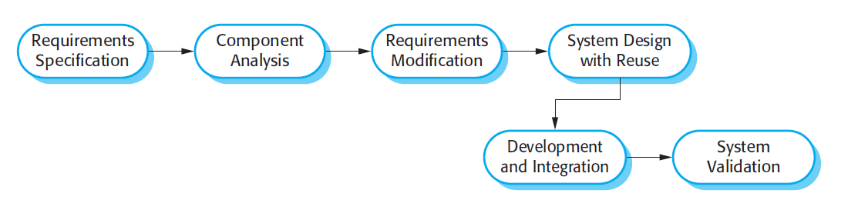
Reuse-oriented software engineering

Slide 15
Types of software component
Web services that are developed according to service standards and which are available for remote invocation.
Collections of objects that are developed as a package to be integrated with a component framework such as .NET or J2EE.
Stand-alone software systems (COTS) that are configured for use in a particular environment.

Slide 16
Process activities
Real software processes are inter-leaved sequences of technical, collaborative and managerial activities with the overall goal of specifying, designing, implementing and testing a software system.
The four basic process activities of specification, development, validation and evolution are organized differently in different development processes. In the waterfall model, they are organized in sequence, whereas in incremental development they are inter-leaved.

Slide 17
Software specification
The process of establishing what services are required and the constraints on the system’s operation and development.
Requirements engineering process
  Feasibility study
    Is it technically and financially feasible to build the system?
  Requirements elicitation and analysis
    What do the system stakeholders require or expect from the system?
  Requirements specification
    Defining the requirements in detail
  Requirements validation
    Checking the validity of the requirements

Slide 18
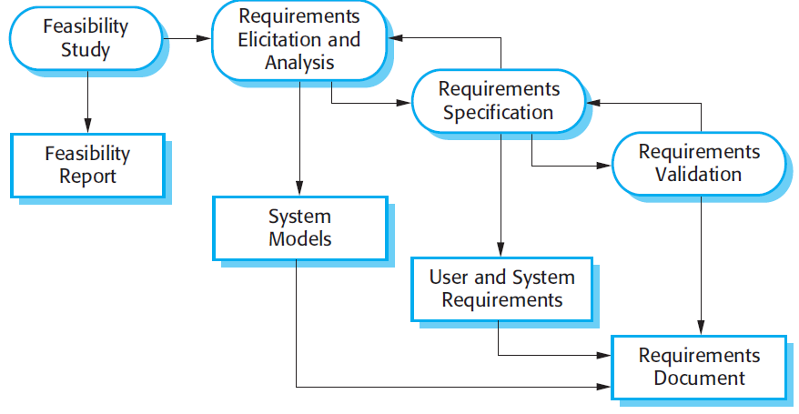
The requirements engineering process

Slide 19
Software design and implementation
The process of converting the system specification into an executable system.
Software design
  Design a software structure that realises the specification;
Implementation
  Translate this structure into an executable program;
The activities of design and implementation are closely related and may be inter-leaved.

Slide 20
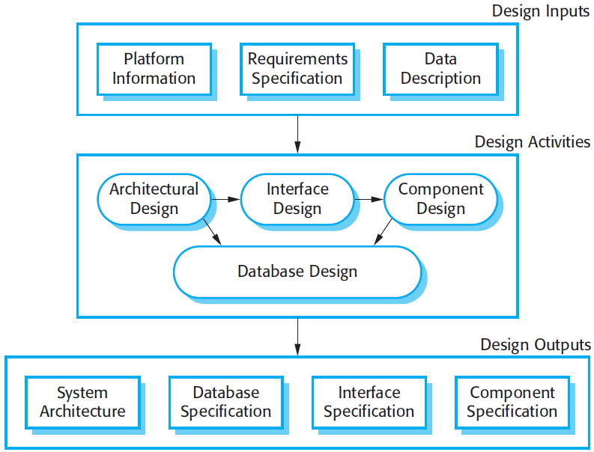
A general model of the design process

Slide 21
Design activities
Architectural design, where you identify the overall structure of the system, the principal components (sometimes called sub-systems or modules), their relationships and how they are distributed.
Interface design, where you define the interfaces between system components.
Component design, where you take each system component and design how it will operate.
Database design, where you design the system data structures and how these are to be represented in a database.

Slide 22
Software validation
Verification and validation (V & V) is intended to show that a system conforms to its specification and meets the requirements of the system customer.
Involves checking and review processes and system testing.
System testing involves executing the system with test cases that are derived from the specification of the real data to be processed by the system.
Testing is the most commonly used V & V activity.

Slide 23
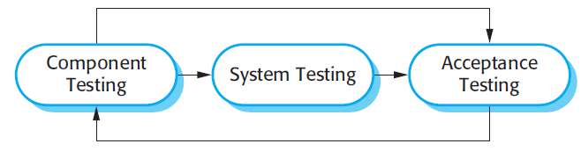
Stages of testing

Slide 24
Testing stages
Development or component testing
  Individual components are tested independently;
  Components may be functions or objects or coherent groupings of these entities.
System testing
  Testing of the system as a whole. Testing of emergent properties is particularly important.
Acceptance testing
  Testing with customer data to check that the system meets the customer’s needs.

Slide 25
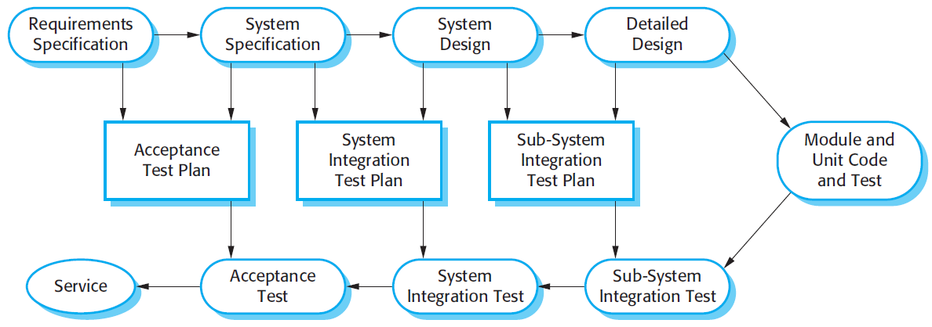
Testing phases in a plan-driven software process

Slide 26
Software evolution
Software is inherently flexible and can change.
As requirements change through changing business circumstances, the software that supports the business must also evolve and change.
Although there has been a demarcation between development and evolution (maintenance) this is increasingly irrelevant as fewer and fewer systems are completely new.

Slide 27
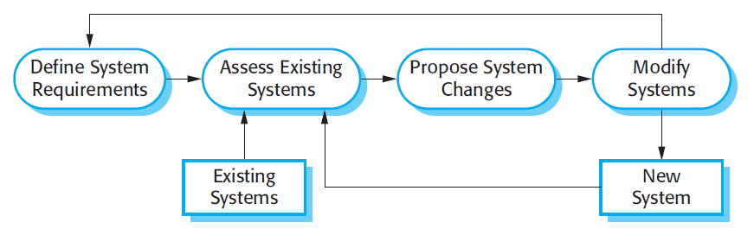
System evolution

Slide 28
Key points
Software processes are the activities involved in producing a software system. Software process models are abstract representations of these processes.
General process models describe the organization of software processes. Examples of these general models include the ‘waterfall’ model, incremental development, and reuse-oriented development.

Slide 29
Key points
Requirements engineering is the process of developing a software specification.
Design and implementation processes are concerned with transforming a requirements specification into an executable software system.
Software validation is the process of checking that the system conforms to its specification and that it meets the real needs of the users of the system.
Software evolution takes place when you change existing software systems to meet new requirements. The software must evolve to remain useful.

Slide 30
Chapter 2 – Software Processes
Lecture 2

Slide 31
Coping with change
Change is inevitable in all large software projects.
  Business changes lead to new and changed system requirements
  New technologies open up new possibilities for improving implementations
  Changing platforms require application changes
Change leads to rework so the costs of change include both rework (e.g. re-analysing requirements) as well as the costs of implementing new functionality

Slide 32
Reducing the costs of rework
Change avoidance, where the software process includes activities that can anticipate possible changes before significant rework is required.
  For example, a prototype system may be developed to show some key features of the system to customers.
Change tolerance, where the process is designed so that changes can be accommodated at relatively low cost.
  This normally involves some form of incremental development. Proposed changes may be implemented in increments that have not yet been developed. If this is impossible, then only a single increment (a small part of the system) may have be altered to incorporate the change.

Slide 33
Software prototyping
A prototype is an initial version of a system used to demonstrate concepts and try out design options.
A prototype can be used in:
  The requirements engineering process to help with requirements elicitation and validation;
  In design processes to explore options and develop a UI design;
  In the testing process to run back-to-back tests.

Slide 34
Benefits of prototyping
Improved system usability.
A closer match to users’ real needs.
Improved design quality.
Improved maintainability.
Reduced development effort.

Slide 35
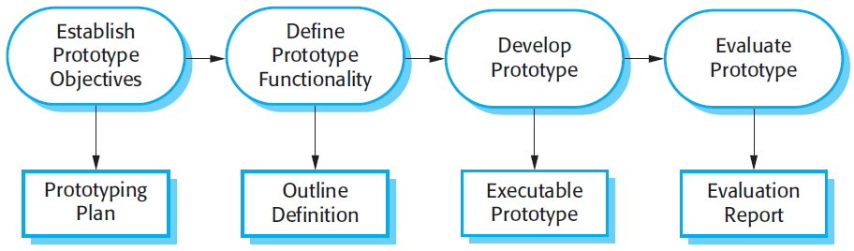
The process of prototype development

Slide 36
Throw-away prototypes
Prototypes should be discarded after development as they are not a good basis for a production system:
  It may be impossible to tune the system to meet non-functional requirements;
  Prototypes are normally undocumented;
  The prototype structure is usually degraded through rapid change;
  The prototype probably will not meet normal organisational quality standards.

Slide 37
Incremental delivery
Rather than deliver the system as a single delivery, the development and delivery is broken down into increments with each increment delivering part of the required functionality.
User requirements are prioritised and the highest priority requirements are included in early increments.
Once the development of an increment is started, the requirements are frozen though requirements for later increments can continue to evolve.

Slide 38
Incremental development and delivery
Incremental development
  Develop the system in increments and evaluate each increment before proceeding to the development of the next increment;
  Normal approach used in agile methods;
  Evaluation done by user/customer proxy.
Incremental delivery
  Deploy an increment for use by end-users;
  More realistic evaluation about practical use of software;
  Difficult to implement for replacement systems as increments have less functionality than the system being replaced.

Slide 39
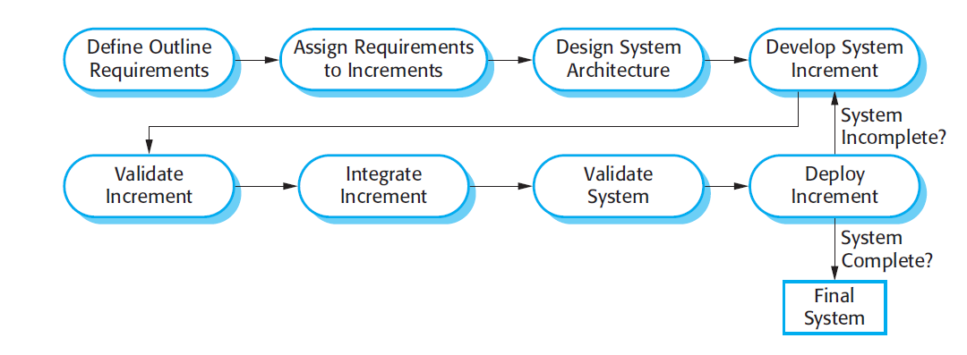
Incremental delivery

Slide 40
Incremental delivery advantages
Customer value can be delivered with each increment so system functionality is available earlier.
Early increments act as a prototype to help elicit requirements for later increments.
Lower risk of overall project failure.
The highest priority system services tend to receive the most testing.

Slide 41
Incremental delivery problems
Most systems require a set of basic facilities that are used by different parts of the system.
  As requirements are not defined in detail until an increment is to be implemented, it can be hard to identify common facilities that are needed by all increments.
The essence of iterative processes is that the specification is developed in conjunction with the software.
  However, this conflicts with the procurement model of many organizations, where the complete system specification is part of the system development contract.

Slide 42
Boehm’s spiral model
Process is represented as a spiral rather than as a sequence of activities with backtracking.
Each loop in the spiral represents a phase in the process.
No fixed phases such as specification or design - loops in the spiral are chosen depending on what is required.
Risks are explicitly assessed and resolved throughout the process.

Slide 43
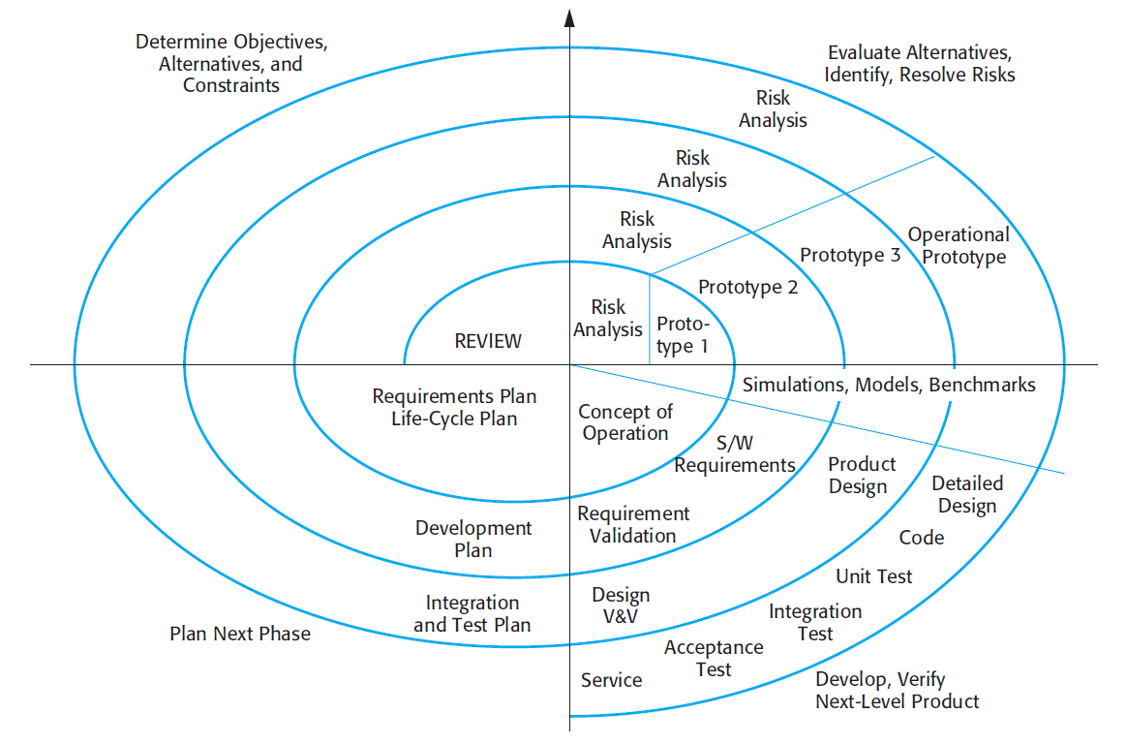
Boehm’s spiral model of the software process

Slide 44
Spiral model sectors
Objective setting
  Specific objectives for the phase are identified.
Risk assessment and reduction
  Risks are assessed and activities put in place to reduce the key risks.
Development and validation
  A development model for the system is chosen which can be any of the generic models.
Planning
  The project is reviewed and the next phase of the spiral is planned.

Slide 45
Spiral model usage
Spiral model has been very influential in helping people think about iteration in software processes and introducing the risk-driven approach to development.
In practice, however, the model is rarely used as published for practical software development.

Slide 46
The Rational Unified Process
A modern generic process derived from the work on the UML and associated process.
Brings together aspects of the 3 generic process models discussed previously.
Normally described from 3 perspectives
  A dynamic perspective that shows phases over time;
  A static perspective that shows process activities;
  A practive perspective that suggests good practice.

Slide 47
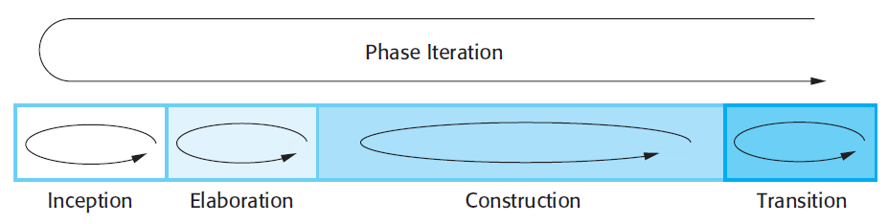
Phases in the Rational Unified Process

Slide 48
RUP phases
Inception
  Establish the business case for the system.
Elaboration
  Develop an understanding of the problem domain and the system architecture.
Construction
  System design, programming and testing.
Transition
  Deploy the system in its operating environment.

Slide 49
RUP iteration
In-phase iteration
  Each phase is iterative with results developed incrementally.
Cross-phase iteration
  As shown by the loop in the RUP model, the whole set of phases may be enacted incrementally.

